Slide 1


Week 7 – Beginner Frontend
ReactJS + Tailwind & DaisyUI
Ryan Agung Samudra
Padang, Sumatra Barat

Slide 2

Github : github.com/ryanagungsamudra
Linkedin : linkedin.com/ryanagungsamudra
Instagram : Instagram.com/ryanagungsamudra
Email : ryansamudra67@gmail.com

Slide 3
OUTLINE PRESENTASI
Pembukaan
Pembahasan
Review Hasil Project
Tanya Jawab
Penutup

Slide 4
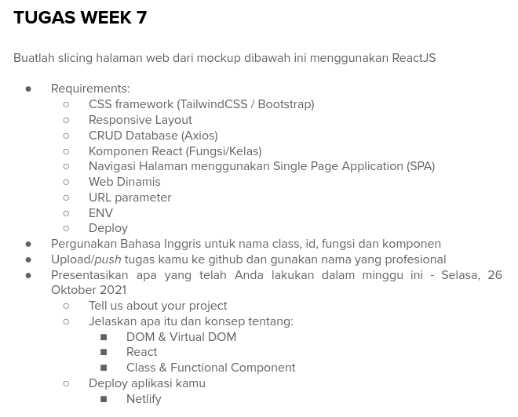

Slide 5
PEMBAHASAN
1. DOM & Virtual DOM
2. React
3. Class & Functional Component

Slide 6
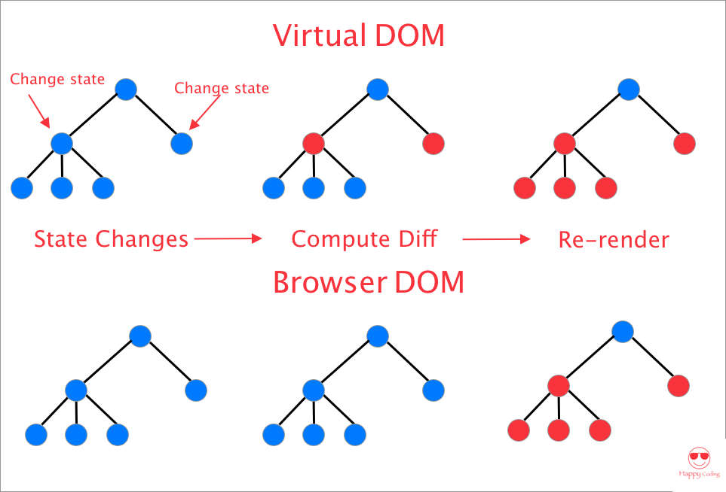
1. DOM & Virtual DOM

Slide 7
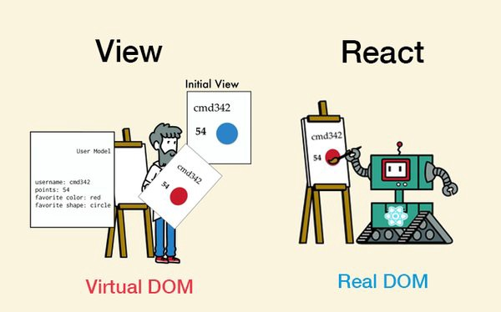
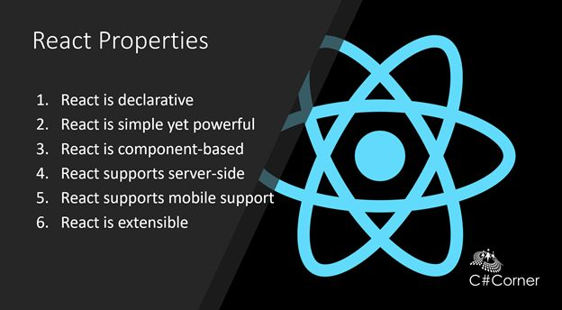
2. REACT

Slide 8
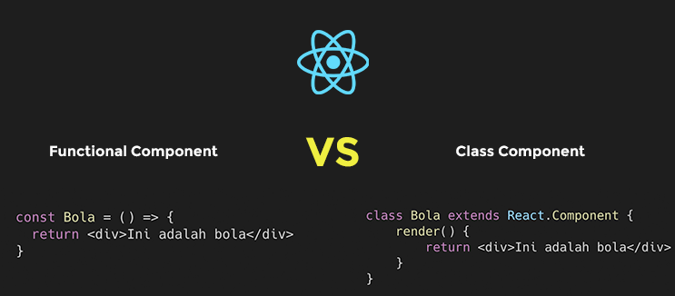
3. Class & Functional Component

Slide 9
HASIL PROJECT

Slide 10
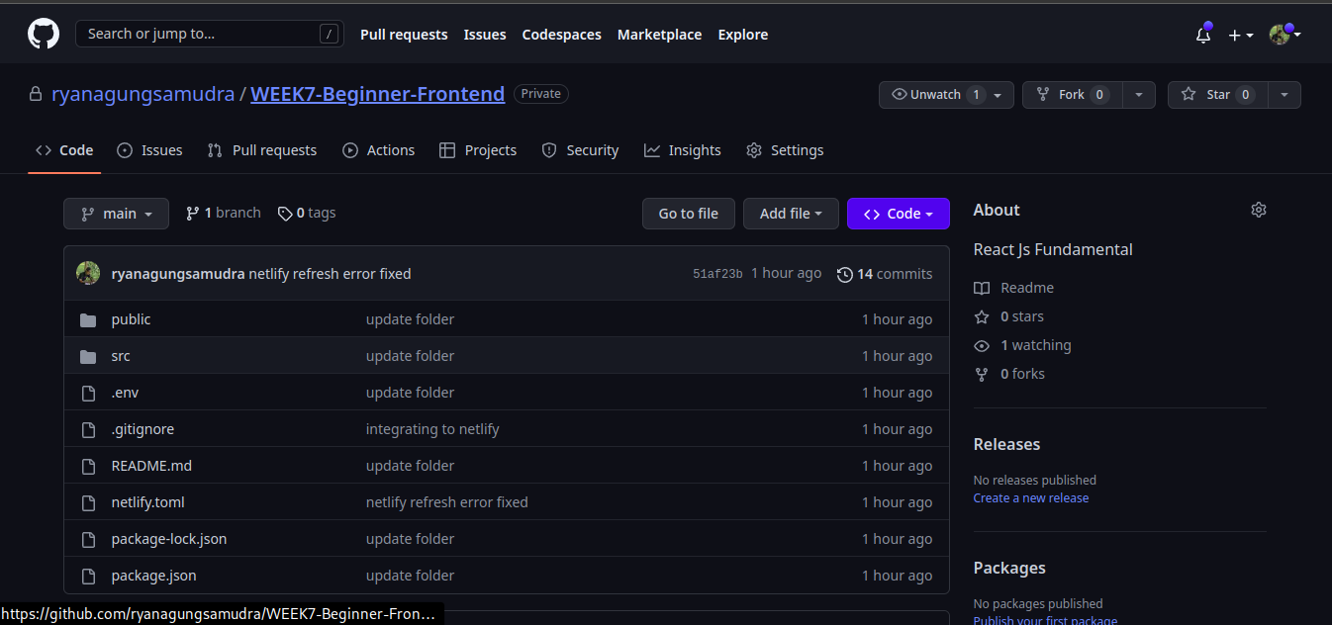
Github
https://github.com/ryanagungsamudra

Slide 11
TERIMAKASIH!

